Slide 1
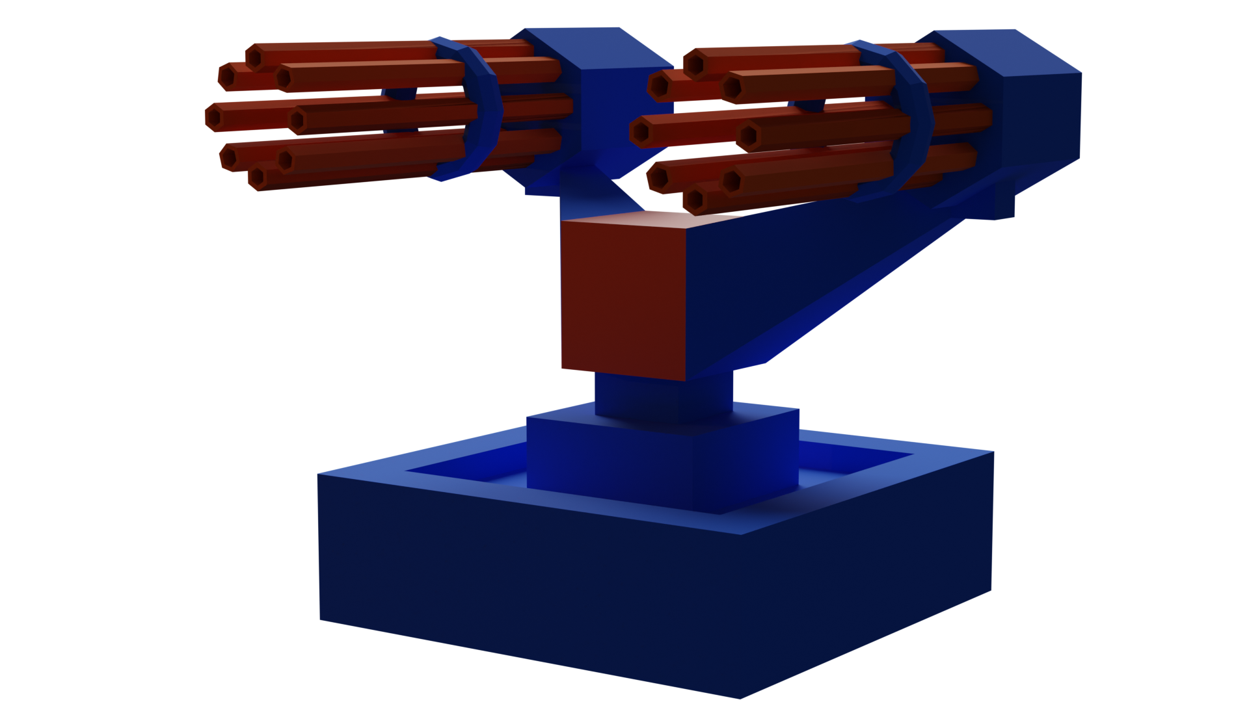
TowerStart Games
Founded in 2020
Released “Woodland Defence” last year
Achieved 100k downloads in first week on iOS
Small team with big pedigree
Located in Brighton – hub for mobile games
Lou Hudson – Senior Producer
Jon Sanders – Design Director
A casual and seamless idle tower defence base building game
James Petworth – Lead Programmer
TowerStart Games
Notes:
Good [morning/afternoon], everyone. Thank you for being here.
I’m Ev, and today I’m thrilled to introduce you to Towerland, a game we’re developing at TowerStart Games.
Towerland is a unique blend of tower defence, idle gaming, and exciting action that keeps players engaged every step of the way.

Slide 2
Manual Mode:
Players may be waiting on buildings or upgrades
They still want to play
Manually aim and snipe enemies
Get additional rewards
Summary:
Towerland is a game where players fight against an endless invasion of enemies by placing and upgrading defensive towers and buildings
TowerStart Games
Founded in 2020
Released “Woodland Defence” last year
Achieved 100k downloads in first week on iOS
Small team with big pedigree
Located in Brighton – hub for mobile games
Lou Hudson – Senior Producer
Jon Sanders – Design Director
A casual and seamless idle tower defence base building game
James Petworth – Lead Programmer
TowerStart Games
Design Pillars:
Convenient, flexible sessions
Frequent progression
Clear and rewarding feedback
Variety of fun and viable strategies
Easy to understand visuals
Variety of genres:
Base Design – players place buildings and décor
Manual sniper mode – players can interact manually for extra rewards
Idle Gameplay – Players come back online to a collection of rewards
Base Design:
Players place upgradable buildings
Slowly build out the fort
Unlock new units
Automatically train units to fight the enemy onslaught
Add décor to the fort
Idle Gameplay:
Players can make progress even afk
Enemies continue to attack while offline
Incoming Boss will send a notification to players
Notes:
Let me tell you a bit about the company behind Towerland, TowerStart Games.
We were founded in 2020 with a mission: to create innovative and engaging mobile games that stand out in the crowded marketplace.
Woodland defence was also a tower defence so shows we have relevant experience
Our small, tight-knit team has a lot of pedigree behind it. Each of our team members brings years of experience in game design, art, and mobile development, meaning we are equipped to deliver high-quality games.
We’re based in Brighton, one of the UK’s key hubs for mobile gaming. Allows us to stay connected with industry trends and talent, ensuring we’re always at the forefront of innovation.
With our proven track record and expertise, we’re confident that TowerStart Games is the perfect team to bring Towerland to life.
People images from https://www.thispersondoesnotexist.com/

Slide 3
Design Pillars:
Convenient, flexible sessions
Frequent progression
Clear and rewarding feedback
Variety of fun and viable strategies
Easy to understand visuals
Variety of genres:
Base Design – players place buildings and décor
Manual sniper mode – players can interact manually for extra rewards
Idle Gameplay – Players come back online to a collection of rewards
Base Design:
Players place upgradable buildings
Slowly build out the fort
Unlock new units
Automatically train units to fight the enemy onslaught
Add décor to the fort
Idle Gameplay:
Players can make progress even afk
Enemies continue to attack while offline
Incoming Boss will send a notification to players
Manual Mode:
Players may be waiting on buildings or upgrades
They still want to play
Manually aim and snipe enemies
Get additional rewards
TowerStart Games
Founded in 2020
Released “Woodland Defence” last year
Achieved 100k downloads in first week on iOS
Small team with big pedigree
Located in Brighton – hub for mobile games
Summary:
Towerland is a game where players fight against an endless invasion of enemies by placing and upgrading defensive towers and buildings
Lou Hudson – Senior Producer
Jon Sanders – Design Director
James Petworth – Lead Programmer
Design Pillars:
Convenient, flexible sessions
Frequent progression
Clear and rewarding feedback
Variety of fun and viable strategies
Easy to understand visuals
Variety of genres:
Base Design – players place buildings and décor
Manual sniper mode – players can interact manually for extra rewards
Idle Gameplay – Players come back online to a collection of rewards
TowerStart Games
Base Design:
Players place upgradable buildings
Slowly build out the fort
Unlock new units
Automatically train units to fight the enemy onslaught
Add décor to the fort
Idle Gameplay:
Players can make progress even afk
Enemies continue to attack while offline
Incoming Boss will send a notification to players
Manual Mode:
Players may be waiting on buildings or upgrades
They still want to play
Manually control turrets and snipe enemies
Get additional rewards
Summary:
Towerland is a game where players fight against an endless invasion of enemies by placing and upgrading defensive towers and buildings
Notes:
Elevator pitch:
Towerland is a low-poly endless idle tower defence game where players build and upgrade towers,
and shoot endless waves of invaders both automatically and manually, and expand territory.
They build towers and troops with skippable wait times via ads or purchases.

Slide 4
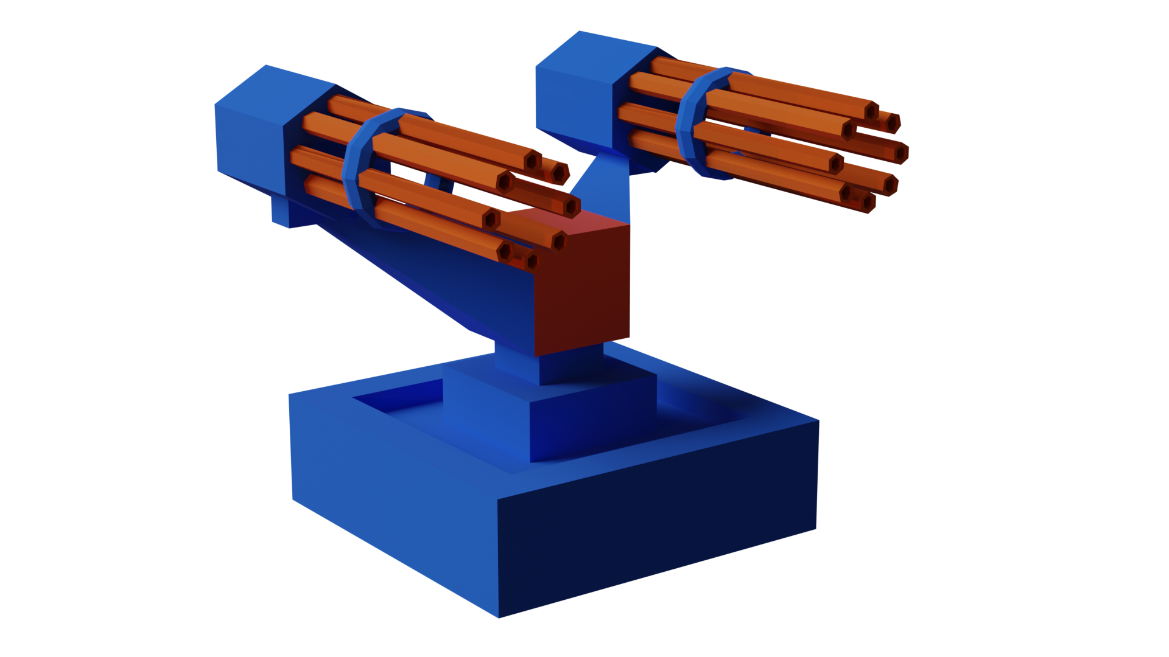
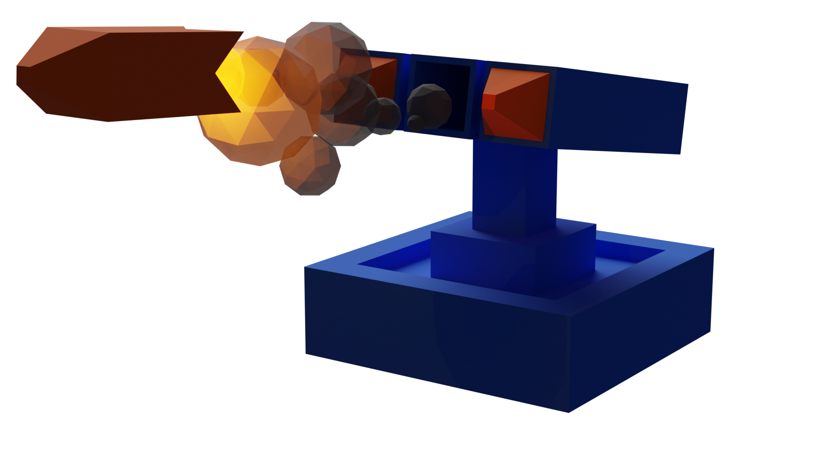
Manual Mode:
Players may be waiting on buildings or upgrades
They still want to play
Manually aim and snipe enemies
Get additional rewards
Summary:
Towerland is a game where players fight against an endless invasion of enemies by placing and upgrading defensive towers and buildings
Design Pillars:
Convenient, flexible sessions
Frequent progression
Clear and rewarding feedback
Variety of fun and viable strategies
Easy to understand visuals
Variety of genres:
Base Design – players place buildings and décor
Manual sniper mode – players can interact manually for extra rewards
Idle Gameplay – Players come back online to a collection of rewards
Base Design:
Players place upgradable buildings
Slowly build out the fort
Unlock new units
Automatically train units to fight the enemy onslaught
Add décor to the fort
Idle Gameplay:
Players can make progress even afk
Enemies continue to attack while offline
Incoming Boss will send a notification to players
Genres: Idle, Strategy, Tower Defence
Why these genres? We have experience as a studio creating great tower defence games, and we feel that the idle genre is particularly compatible, as well as becoming more popular in its own right.
Art Style: Low Poly, Colourful
Why this art style? Low poly art is very readable on a small screen such as on a mobile device and is comparably one of the most inexpensive art styles both financially and in terms of a time investment.
Manual Mode:
Players may be waiting on buildings or upgrades
They still want to play
Manually control turrets and snipe enemies
Get additional rewards
Target Audience: Children & Young Adults aged 7-28
Why this audience? Due to the simple, clean, professional art style that will appeal to adults and the bright colours/simple gameplay which will appeal to kids.
Summary:
Towerland is a game where players fight against an endless invasion of enemies by placing and upgrading defensive towers and buildings
Design Pillars:
Convenient, flexible sessions
Frequent progression
Clear and rewarding feedback
Variety of fun and viable strategies
Easy to understand visuals
Variety of genres:
Base Design – players place buildings and décor
Manual sniper mode – players can interact manually for extra rewards
Idle Gameplay – Players come back online to a collection of rewards
Base Design:
Players place upgradable buildings
Slowly build out the fort
Unlock new units
Automatically train units to fight the enemy onslaught
Add décor to the fort
Idle Gameplay:
Players can make progress even afk
Enemies continue to attack while offline
Incoming Boss will send a notification to players
Notes:
Base Design:
Players can place, upgrade, and decorate buildings with fun and aesthetic low poly assets.
Manual Mode:
Players may still have time to kill and want to engage with the game even while they are waiting for the timers associated with building and upgrading structures and towers. Players can take control of any tower in the game and each has a unique feel.
Players gain extra rewards in this mode but it is not required that they play it.
Idle Gameplay:
Towerland will feature a satisfying sense of improvement and progression over time, as it crucial to idle games.
Players are expected to make at least 50% of their progress while idle

Slide 5
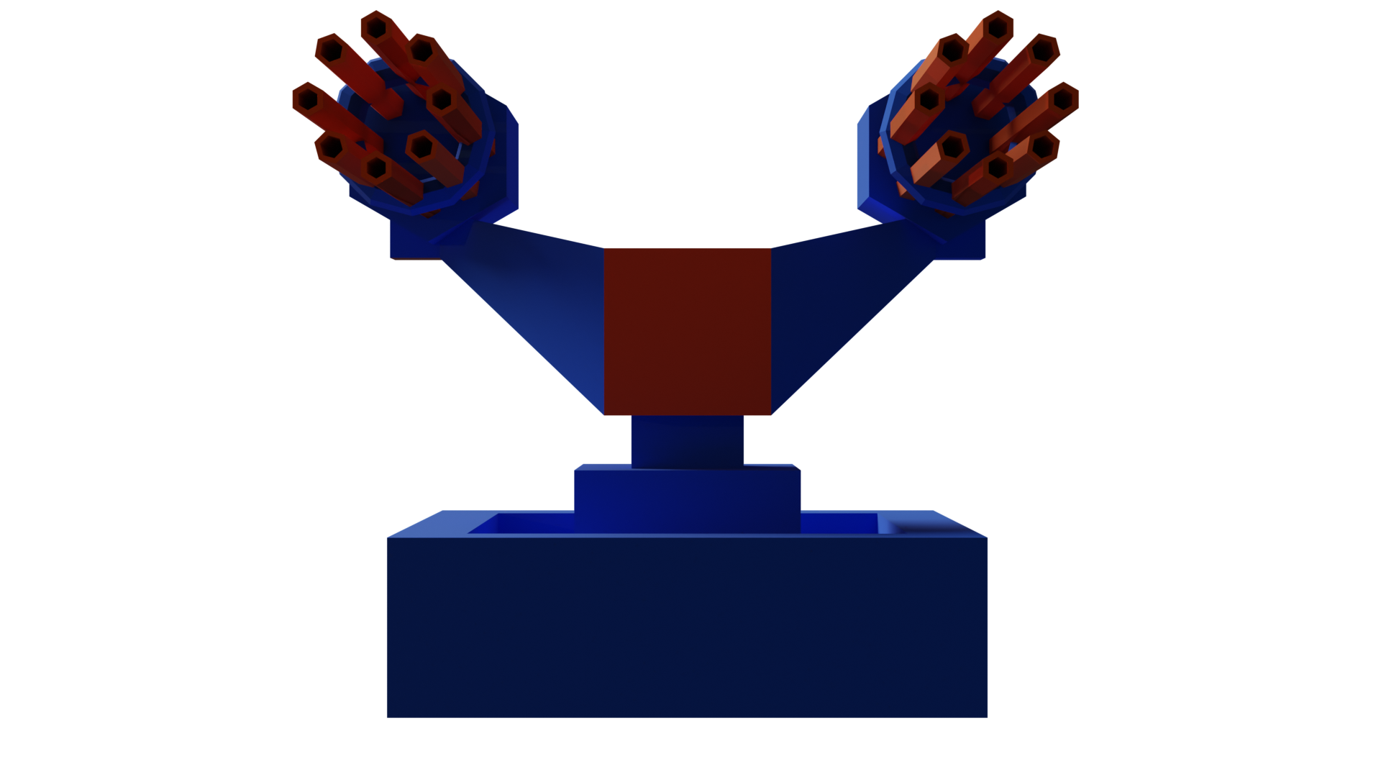
Design Pillars:
Convenient, flexible sessions
Frequent progression
Clear and rewarding feedback
Variety of fun and viable strategies
Easy to understand visuals
Variety of genres:
Base Design – players place buildings and décor
Manual sniper mode – players can interact manually for extra rewards
Idle Gameplay – Players come back online to a collection of rewards
Base Design:
Players place upgradable buildings
Slowly build out the fort
Unlock new units
Automatically train units to fight the enemy onslaught
Add décor to the fort
Idle Gameplay:
Players can make progress even afk
Enemies continue to attack while offline
Incoming Boss will send a notification to players
Genres: Idle, Strategy, Tower Defence
Why these genres? We have experience as a studio creating great tower defence games, and we feel that the idle genre is particularly compatible, as well as becoming more popular in its own right.
Start building construction
Core gameplay loop
Spend rewards on upgrading and buying buildings
Play manual gamemode while waiting
Art Style: Low Poly, Colourful
Why this art style? Low poly art is very readable on a small screen such as on a mobile device and is comparably one of the most inexpensive art styles both financially and in terms of a time investment.
Complete buildings, collect XP
Enemies drop rewards
Target Audience: Children & Young Adults aged 7-28
Why this audience? Due to the simple, clean, professional art style that will appeal to adults and the bright colours/simple gameplay which will appeal to kids.
Buildings shoot at enemies
Manual Mode:
Players may be waiting on buildings or upgrades
They still want to play
Manually control turrets and snipe enemies
Get additional rewards
Summary:
Towerland is a game where players fight against an endless invasion of enemies by placing and upgrading defensive towers and buildings
Notes:
Taking elements that work the best from both idle games and strategy games and combining them into a hybrid genre
allows us to rely on decades of previous knowledge from other studios while still producing a unique end product
Discuss target audience

Slide 6
Core gameplay loop
Start building construction
Genres: Idle, Strategy, Tower Defence
Why these genres? We have experience as a studio creating great tower defence games, and we feel that the idle genre is particularly compatible, as well as becoming more popular in its own right.
Why Mobile?
The mobile gaming industry generated approximately $136 billion in revenue in 2023, outpacing the combined revenue of the film and music industries. This figure is expected to grow beyond $150 billion by 2024. (Le, 2024; Baltezarević & Baltezarević, 2024)
Spend rewards on upgrading and buying buildings
Play manual gamemode while waiting
Art Style: Low Poly, Colourful
Why this art style? Low poly art is very readable on a small screen such as on a mobile device and is comparably one of the most inexpensive art styles both financially and in terms of a time investment.
Complete buildings, collect XP
Enemies drop rewards
Market Penetration: Over 92% of global internet users play mobile games, highlighting mobile gaming's unparalleled reach. (Moon, 2024)
Target Audience: Children & Young Adults aged 7-28
Why this audience? Due to the simple, clean, professional art style that will appeal to adults and the bright colours/simple gameplay which will appeal to kids.
Towerland relies on very short, very frequent play sessions, and the idle progress that the player makes in between these sessions. This type of gameplay loop with micro-length play sessions is currently best suited to mobile.
Buildings shoot at enemies
Notes:
The gameplay loop is quite simple.
Players might also spend time rearranging or decorating their base in between building.
Minigames could be implemented into each building type, for example a barracks might have a training minigame.

Slide 7
Core gameplay loop
Why Mobile?
Start building construction
Towerland targets an ever-growing niche in the mobile game market: Idle gamers who want to drop into the game while waiting for a bus or on a short break at work, make some progress, and drop out again.
The mobile gaming industry generated approximately $136 billion in revenue in 2023, outpacing the combined revenue of the film and music industries. This figure is expected to grow beyond $150 billion by 2024. (Le, 2024; Baltezarević & Baltezarević, 2024)
Spend rewards on upgrading and buying buildings
Play manual gamemode while waiting
"Short mobile gaming sessions, lasting around 5 minutes on average, align perfectly with modern user habits, such as playing while waiting in line or during short breaks." (Moon, 2024)
Market Penetration: Over 92% of global internet users play mobile games, highlighting mobile gaming's unparalleled reach. (Moon, 2024)
Complete buildings, collect XP
Enemies drop rewards
“4G networks in the UK exhibited a 97.8% connection success rate on average, respectively, when a mobile device becomes active. This suggests that mobile games enjoy much more robust network connectivity, which means players can use online features anywhere.” (Moon, 2024)
Towerland relies on very short, very frequent play sessions, and the idle progress that the player makes in between these sessions. This type of gameplay loop with micro-length play sessions is currently best suited to mobile.
Buildings shoot at enemies
Notes:
Many idle games are on the web. We have decided to produce a mobile app and not a web game as the scope for revenue is simply much greater,
And it is easier to keep players engaged and invested in an app as they have already gone through the effort of downloading it.
Baltezarević, R., & Baltezarević, I. (2024). Ensure Video Game Success with Digital Marketing. Taylor & Francis.
Moon, D. (2024). Network Traffic Characteristics in Recent Mobile Games. https://www.mdpi.com/2076-3417/14/4/1397/pdf

Slide 8
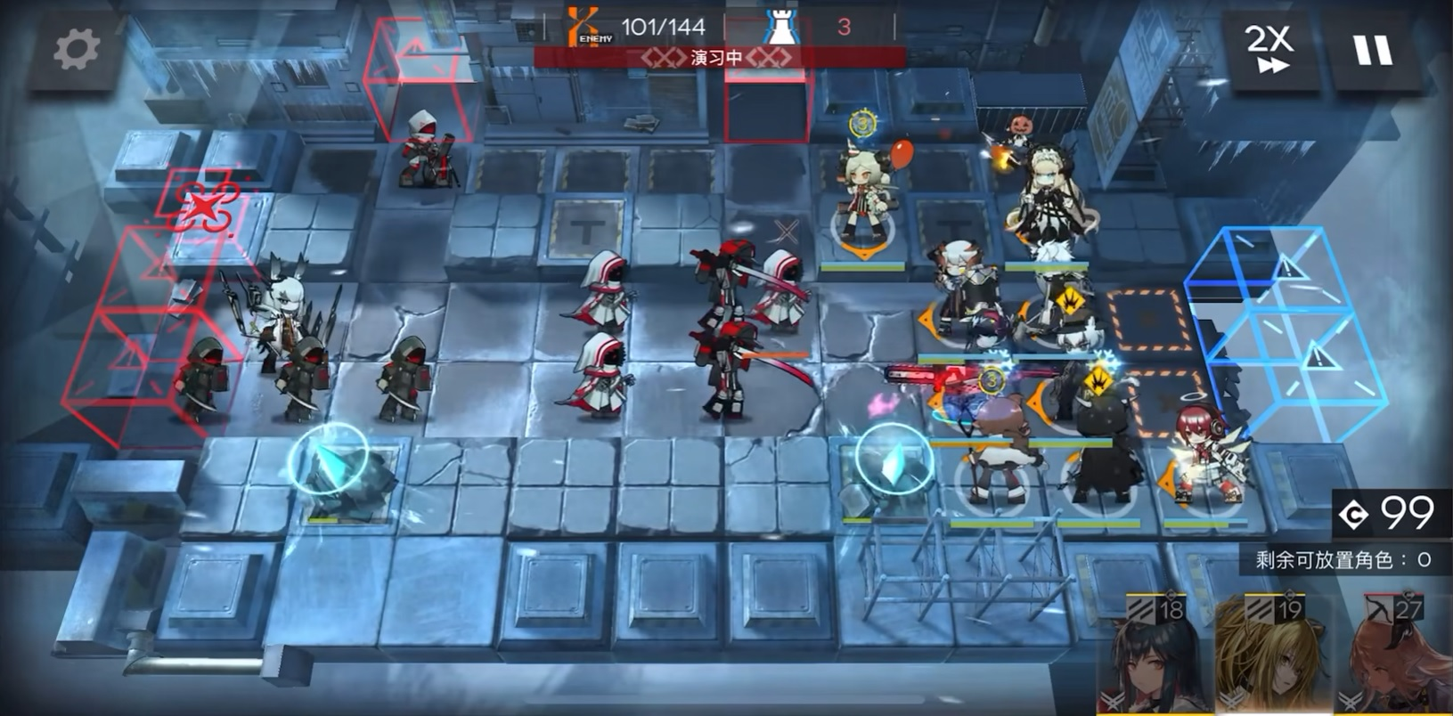
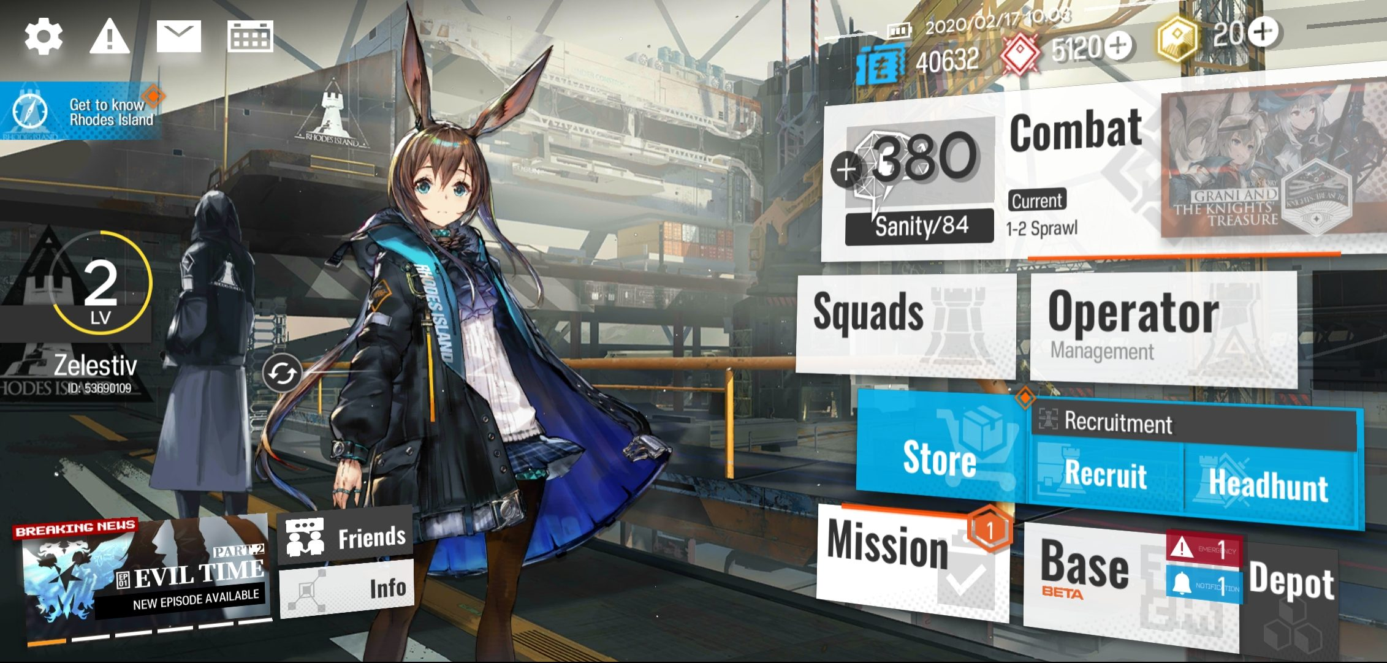
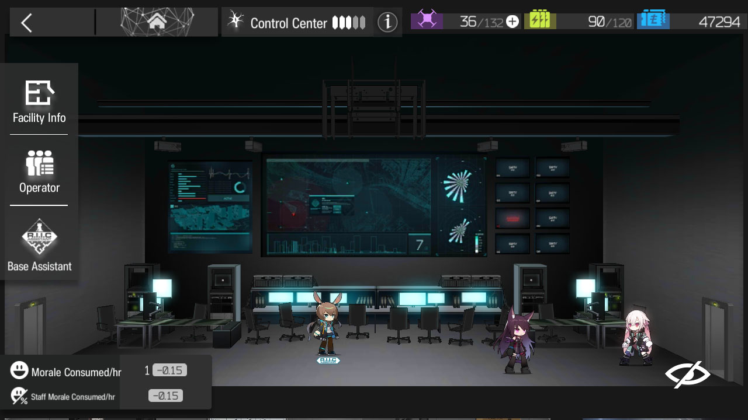
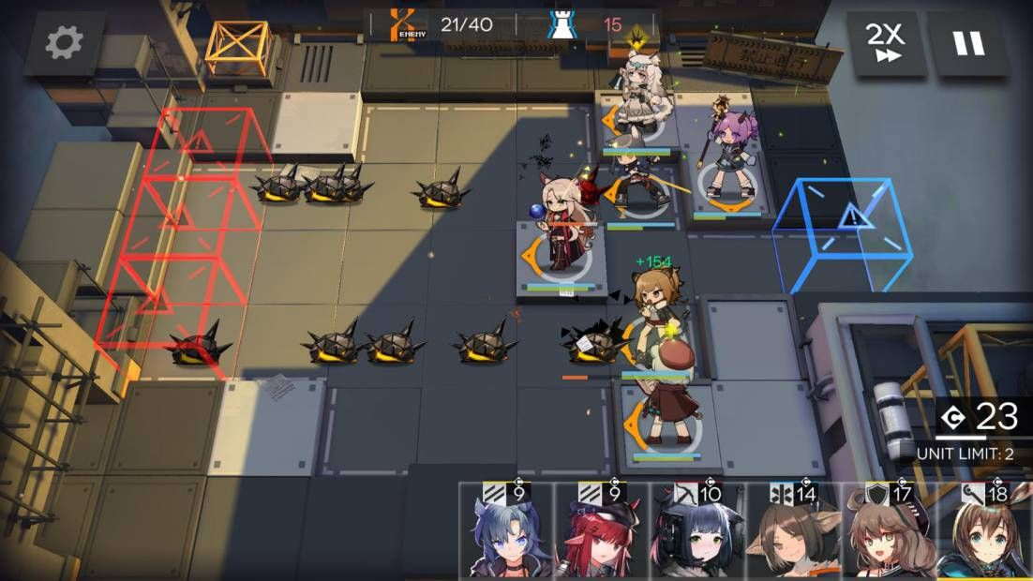
Why Mobile?
Towerland targets an ever-growing niche in the mobile game market: Idle gamers who want to drop into the game while waiting for a bus or on a short break at work, make some progress, and drop out again.
The mobile gaming industry generated approximately $136 billion in revenue in 2023, outpacing the combined revenue of the film and music industries. This figure is expected to grow beyond $150 billion by 2024. (Le, 2024; Baltezarević & Baltezarević, 2024)
"Short mobile gaming sessions, lasting around 5 minutes on average, align perfectly with modern user habits, such as playing while waiting in line or during short breaks." (Moon, 2024)
Market Penetration: Over 92% of global internet users play mobile games, highlighting mobile gaming's unparalleled reach. (Moon, 2024)
“4G networks in the UK exhibited a 97.8% connection success rate on average, respectively, when a mobile device becomes active. This suggests that mobile games enjoy much more robust network connectivity, which means players can use online features anywhere.” (Moon, 2024)
Towerland relies on very short, very frequent play sessions, and the idle progress that the player makes in between these sessions. This type of gameplay loop with micro-length play sessions is currently best suited to mobile.
Singleplayer, Casual
Launched in 2020
4.7/5 stars
5 million+ downloads
(f2p)
Gacha monetisation
Tower defence
Strong story elements
Large player base
Multiple genres combined
Notes:
Towerland relies on very short, very frequent play sessions, and the idle progress that the player makes in between these sessions.
The game is more suited to being played while waiting for a train or killing 5 minutes before bed than it is for long play sessions.
This is by design as this type of short gameplay loop relying on microsessions has been shown to increase retention; hence it is becoming more popular in the mobile game space.
Players can use online features like clans and leaderboards everywhere because these days everyone has very fast 4G or 5G on their phones

Slide 9
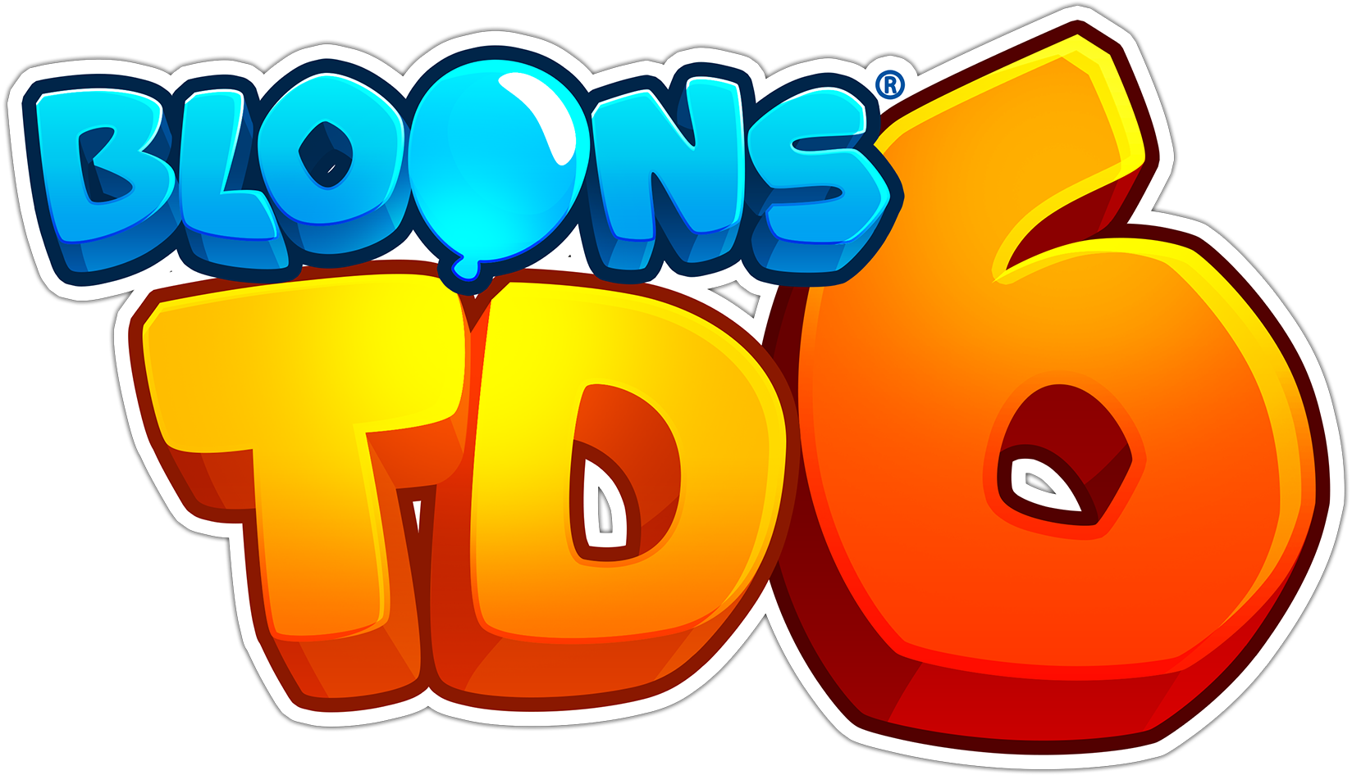
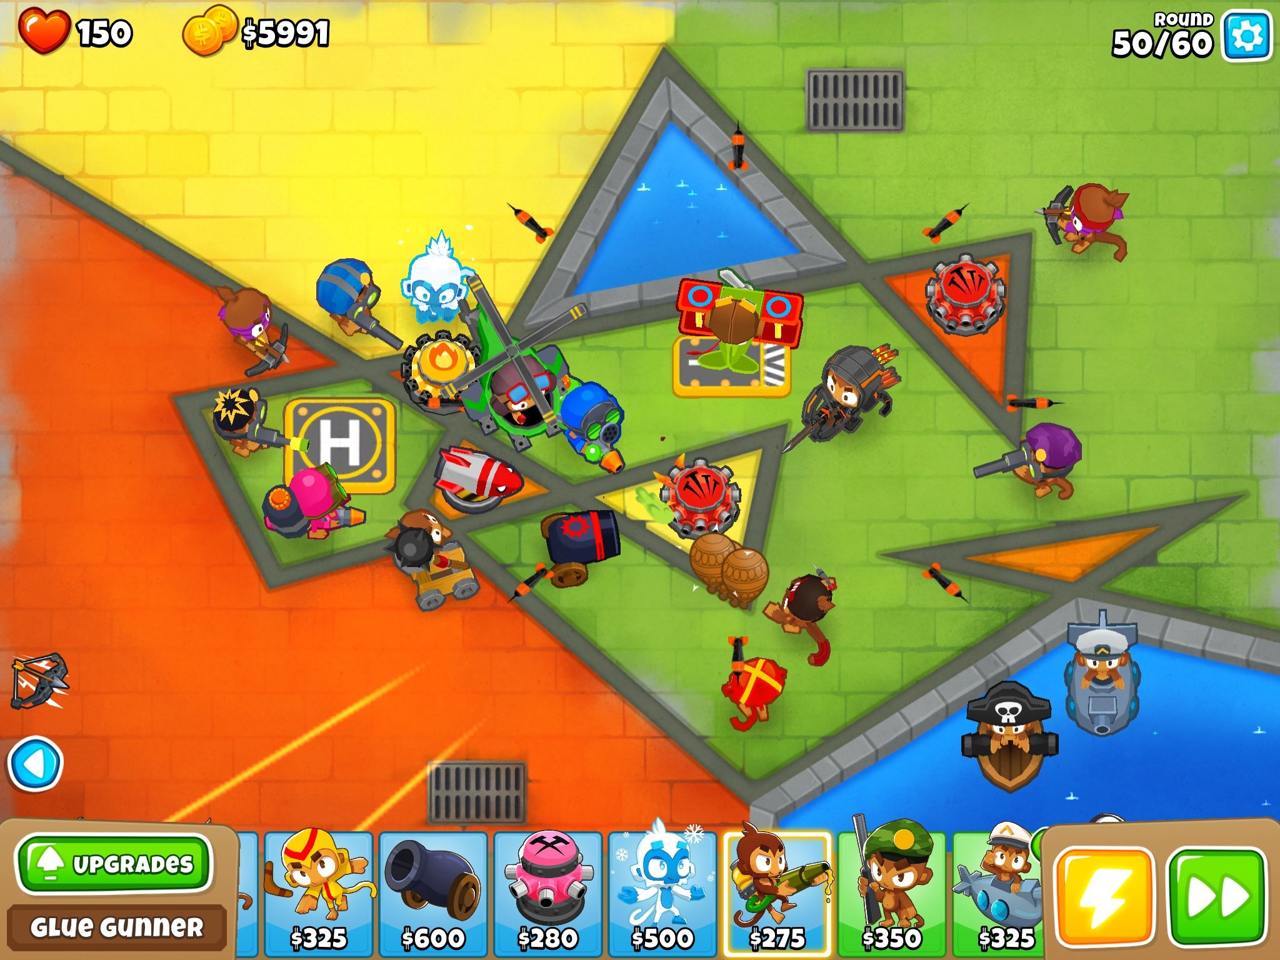
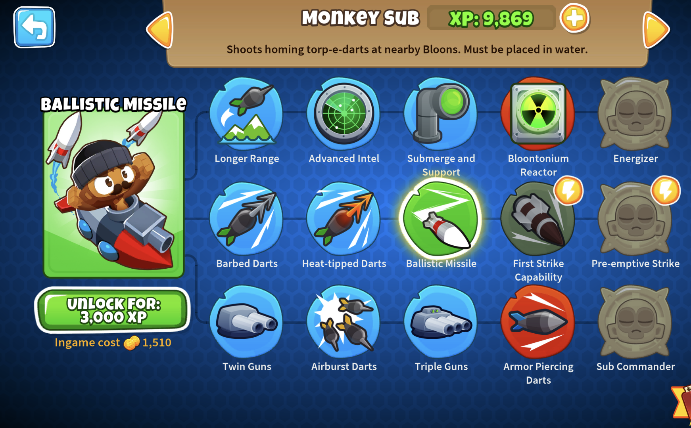
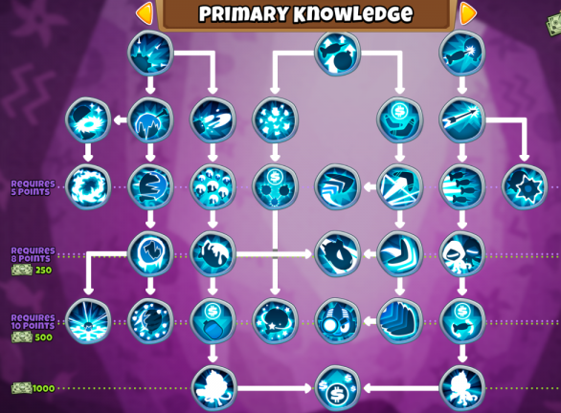
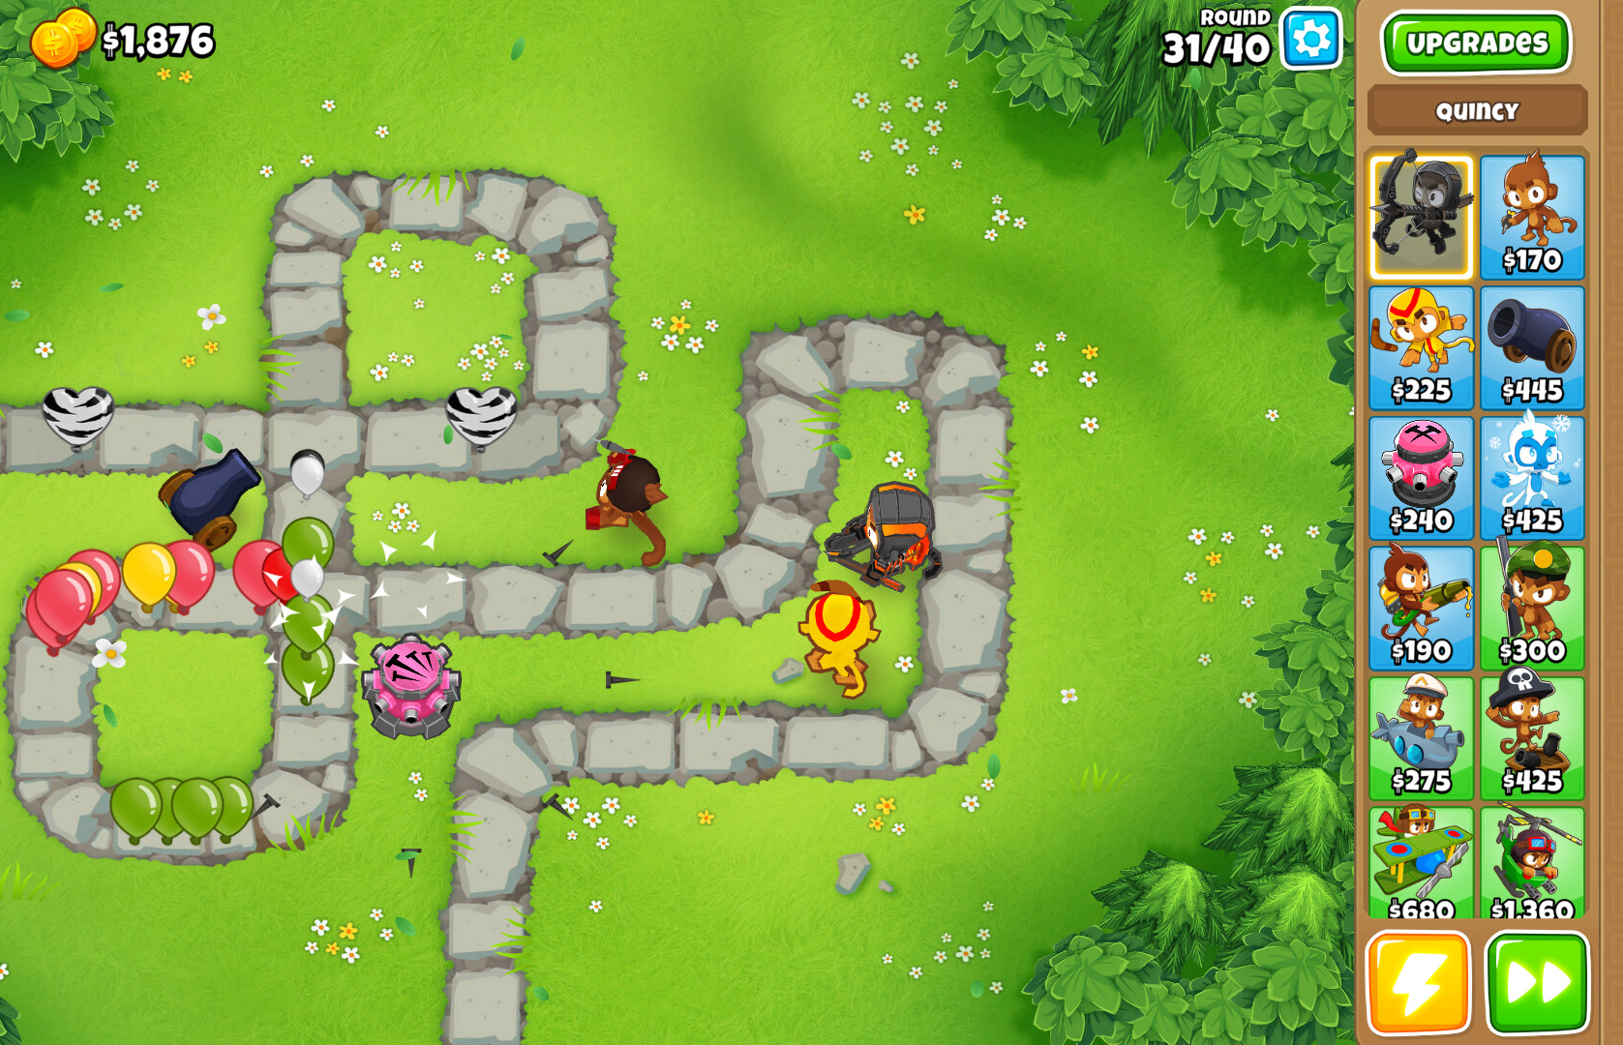
Towerland targets an ever-growing niche in the mobile game market: Idle gamers who want to drop into the game while waiting for a bus or on a short break at work, make some progress, and drop out again.
Singleplayer, Casual
Launched in 2020
4.7/5 stars
5 million+ downloads
(f2p)
Gacha monetisation
Tower defence
Strong story elements
Large player base
Multiple genres combined
Singleplayer
Launched in 2018
4.8/5 stars
1 million+ downloads
($6.99) paid app
Popular on multiple platforms
Notable for being Paid instead of f2p
Many upgrade paths for towers
Players can still buy in-game currency
"Short mobile gaming sessions, lasting around 5 minutes on average, align perfectly with modern user habits, such as playing while waiting in line or during short breaks." (Moon, 2024)
“4G networks in the UK exhibited a 97.8% connection success rate on average, respectively, when a mobile device becomes active. This suggests that mobile games enjoy much more robust network connectivity, which means players can use online features anywhere.” (Moon, 2024)
Notes:
Arknights is a tactical tower defense game with gacha elements, set in a dystopian world. Players assume the role of a commander,
deploying various "Operators" with unique skills to fend off enemy waves. The game features strategic gameplay, a compelling narrative,
base-building mechanics, and high-quality art and music, appealing to both strategy enthusiasts and those interested in character collection.
Images Copyright: Arknights/Hypergryph

Slide 10
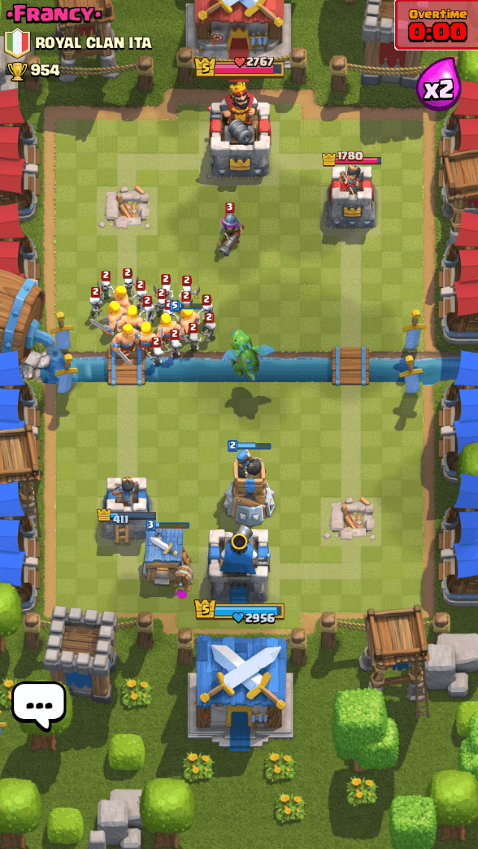
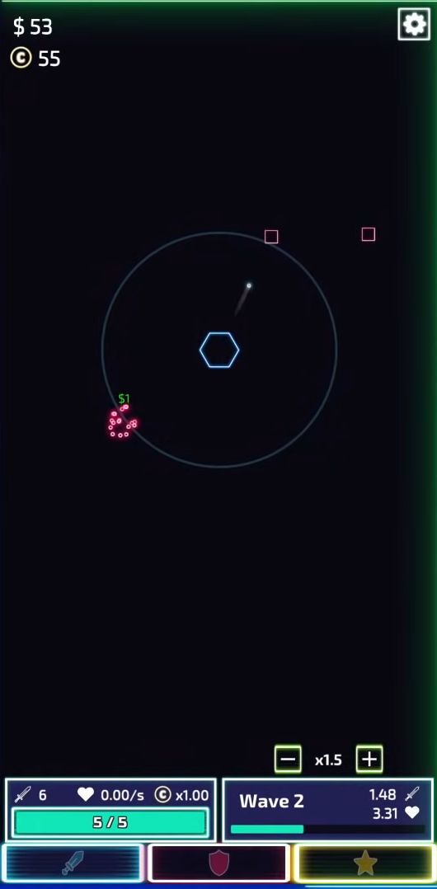
Multiplayer
Launched in 2016
4.6/5 stars
100 million+ downloads
(f2p)
Competitive strategy
Realtime
Numerous characters
Cartoon art style
Singleplayer
1 million+ downloads
(f2p)
4.8/5 stars
Hypercasual
Comparable to Towerland
Idle tower defence
Viral marketing via TikTok
Minimal art
Singleplayer
Launched in 2018
4.8/5 stars
1 million+ downloads
($6.99) paid app
Popular on multiple platforms
Notable for being Paid instead of f2p
Many upgrade paths for towers
Players can still buy in-game currency
Singleplayer, Casual
Launched in 2020
4.7/5 stars
5 million+ downloads
(f2p)
Gacha monetisation
Tower defence
Strong story elements
Large player base
Multiple genres combined
Notes:
“Bloons TD 6 is a vibrant tower defense game where players deploy monkey towers to prevent waves of balloons ("Bloons") from reaching the end of a path.
The game offers diverse tower types, each with unique abilities and upgrade paths, and introduces 3D graphics, new Bloon types, and heroes with special skills.
Players can enjoy various game modes and challenges, providing extensive replayability. “ – Bloons TD Wiki Images Copyright: Bloons TD 6/NinjaKiwi

Slide 11
What makes Towerland unique?
An immersive low-poly aesthetic: visually appealing, cost-effective, and device-friendly.
Singleplayer
Launched in 2018
4.8/5 stars
1 million+ downloads
($6.99) paid app
Popular on multiple platforms
Notable for being Paid instead of f2p
Many upgrade paths for towers
Players can still buy in-game currency
Singleplayer
1 million+ downloads
(f2p)
4.8/5 stars
Hypercasual
Comparable to Towerland
Idle tower defence
Viral marketing via TikTok
Minimal art
A blended gameplay loop combining idle mechanics, active control of turrets/sniping, and strategic fort-building.
Multiplayer
Launched in 2016
4.6/5 stars
100 million+ downloads
(f2p)
Competitive strategy
Realtime
Numerous characters
Cartoon art style
A dynamic challenge curve: As players expand territory, they have more territory to defend, creating a natural difficulty curve.
Previously shipped popular game “Woodland Defence” allows us an audience of repeat customers who already have confidence that TowerStart Games makes excellent tower defence games.
Notes:
Clash Royale is a real-time strategy game that combines elements of collectible card games and tower defence.
Players collect and upgrade cards featuring Clash of Clans troops, spells, and defences, and then duel other players online.
The objective is to destroy the opponent's towers while defending one's own, utilizing strategic card deployment and resource management.
Images Copyright: Clash Royale/Supercell
-------------------------------------------------------------------------------------------------------------------------------------------------------------------
The Tower is an idle tower defense game where players build and upgrade a single tower to withstand endless waves of enemies.
The game emphasizes incremental progression, allowing players to enhance their tower's capabilities over time, even when offline.
Its minimalist design and straightforward mechanics make it accessible, while the depth of upgrades provides long-term engagement.
Images Copyright: Tech Tree Games

Slide 12
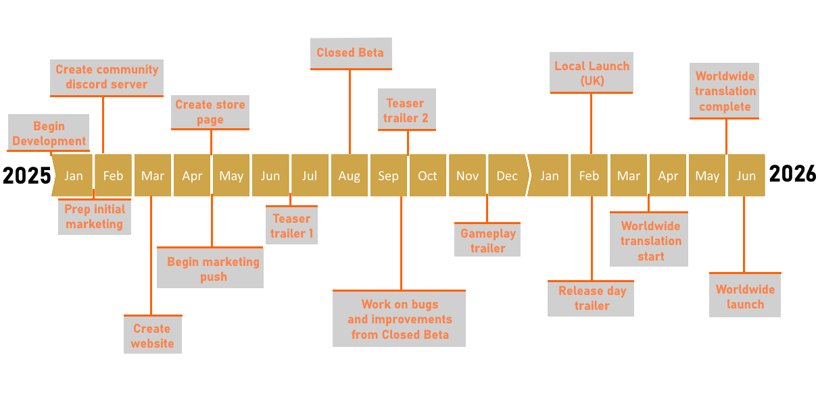
What makes Towerland unique?
Development & Marketing timeline
We plan to complete development in 12 months, aiming for a soft launch in early 2026.
Initial focus: Core mechanics and a beta for balancing the progression
Marketing ramp-up: 3 months before launch with social media campaigns and influencer partnerships.
Singleplayer
1 million+ downloads
(f2p)
4.8/5 stars
Hypercasual
Comparable to Towerland
Idle tower defence
Viral marketing via TikTok
Minimal art
An immersive low-poly aesthetic: visually appealing, cost-effective, and device-friendly.
A blended gameplay loop combining idle mechanics, active control of turrets/sniping, and strategic fort-building.
Multiplayer
Launched in 2016
4.6/5 stars
100 million+ downloads
(f2p)
Competitive strategy
Realtime
Numerous characters
Cartoon art style
A dynamic challenge curve: As players expand territory, they have more territory to defend, creating a natural difficulty curve.
Previously shipped popular game “Woodland Defence” allows us an audience of repeat customers who already have confidence that TowerStart Games makes excellent tower defence games.
Notes:
Blend of different genres
More relaxed approach to strategy
No fail state – player can have minor setbacks but theres no way to die or lose everything. Most setbacks can be rectified with some in game resources in about 30secs

Slide 13
Development & Marketing timeline
We plan to complete development in 12 months, aiming for a soft launch in early 2026.
Initial focus: Core mechanics and a beta for balancing the progression
Marketing ramp-up: 3 months before launch with social media campaigns and influencer partnerships.
What makes Towerland unique?
An immersive low-poly aesthetic: visually appealing, cost-effective, and device-friendly.
Active user targets:
A blended gameplay loop combining idle mechanics, active control of turrets/sniping, and strategic fort-building.
First 6 Months: 350,000+
A dynamic challenge curve: As players expand territory, they have more territory to defend, creating a natural difficulty curve.
First Year: 600,000+
Second Year: 800,000+
Previously shipped popular game “Woodland Defence” allows us an audience of repeat customers who already have confidence that TowerStart Games makes excellent tower defence games.
Notes:
We can have a short development cycle because of the low poly art style and relatively simple game loop.
A lot of the game is reused often, which is frequently the case in idle games, and makes development much easier. Beyond 2026 – depending on the performance of the game there is plenty of scope to do updates post-release, which would increase retention greatly.

Slide 14
Marketing Strategy
Development & Marketing timeline
We plan to complete development in 12 months, aiming for a soft launch in early 2026.
Initial focus: Core mechanics and a beta for balancing the progression
Marketing ramp-up: 3 months before launch with social media campaigns and influencer partnerships.
Collaboration with mobile gaming influencers to showcase gameplay directly to the target audience
Active user targets:
First 6 Months: 350,000+
Targeted ads on platforms like Instagram, Reddit, TikTok, and YouTube (Specifically YouTube Shorts)
First Year: 600,000+
Second Year: 800,000+
Community-building via Discord for direct player feedback.
Focus on app store optimization to ensure visibility in the crowded mobile market.
Notes:
Idle games have a reputation for having very high retention curves, for example one of the most famous idle games, Cookie Clicker.
Even though our growth is expected to slowly drop off after about 1 year in, we predict that we will be able to retain a large portion of our userbase for an extremely long time, especially with supplementary post-release updates.
Opportunity to add extra monetisation in updates afterwards

Slide 15
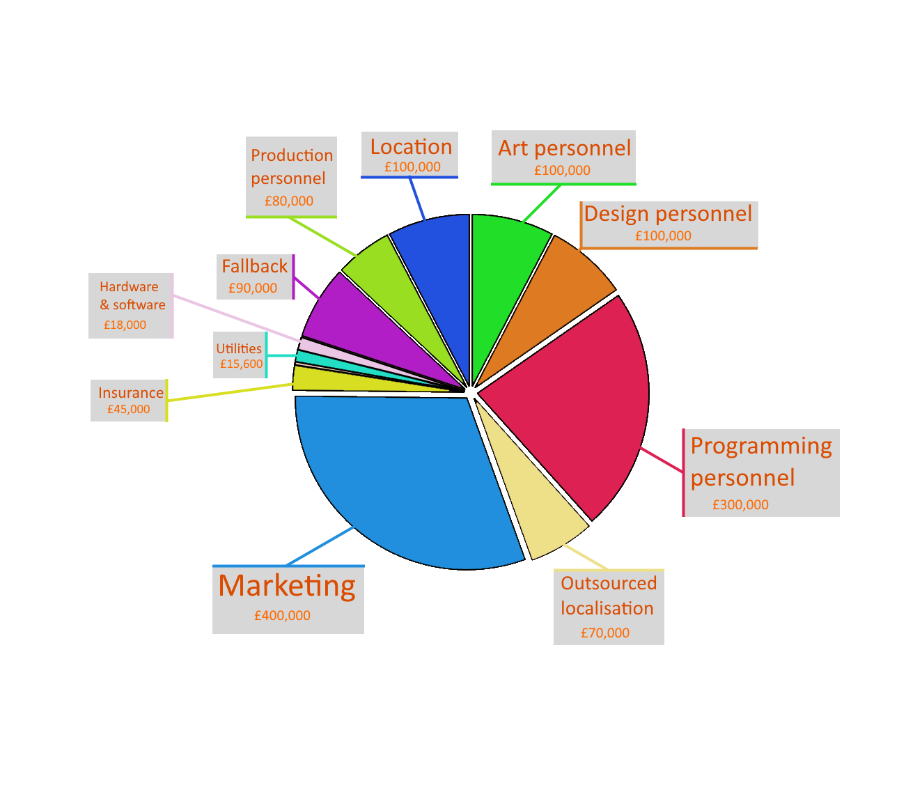
Our projected development costs are £1,500,000 including art, programming, and marketing.
Revenue streams: In-app purchases, ad views, and optional subscriptions.
Monetization aligns with the industry standard while keeping the game fair and enjoyable for all players.
Marketing Strategy
Active user targets:
Collaboration with mobile gaming influencers to showcase gameplay directly to the target audience
Targeted ads on platforms like Instagram, Reddit, TikTok, and YouTube (Specifically YouTube Shorts)
First 6 Months: 350,000+
First Year: 600,000+
Second Year: 800,000+
We have secured £400,000 in funding from our Kickstarter, and are providing an additional £100,000 of our own funds.
This means we require another £1,000,000 to fund the development up until release.
Focus on app store optimization to ensure visibility in the crowded mobile market.
Community-building via Discord for direct player feedback.
Notes:
The Tower by Tech Tree limited has been undertaking a huge online marketing campaign with targeted, casual, relatable ads showing off the satisfying gameplay. We would hope to do something similar
Creating a community is a lot of work but is worth it because it encourages people to discuss the game
We can have a share button in the game for highscores, people can share their achievements on social media

Slide 16
Marketing Strategy
Our projected development costs are £1,500,000 including art, programming, and marketing.
Revenue streams: In-app purchases, ad views, and optional subscriptions.
Monetization aligns with the industry standard while keeping the game fair and enjoyable for all players.
Targeted ads on platforms like Instagram, Reddit, TikTok, and YouTube (Specifically YouTube Shorts)
Collaboration with mobile gaming influencers to showcase gameplay directly to the target audience
We will primarily rely on players skipping timers, such as the time it takes to construct new buildings and towers, for our monetisation strategy. Players will be able to use premium currency or watch ads
to reduce or skip these timers.
"Idle mechanics generate sustained player retention even during inactive gameplay, ensuring consistent ad revenue streams." (Sorvari, 2018)
Focus on app store optimization to ensure visibility in the crowded mobile market.
We have secured £400,000 in funding from our Kickstarter, and are providing an additional £100,000 of our own funds.
This means we require another £1,000,000 to fund the development up until release.
In-App Ads Growth: Revenue from in-game advertising alone is projected
to hit $56 billion by 2024, indicating the importance of
ad-based monetization models for free-to-play games. (Mäkinen, 2022)
Community-building via Discord for direct player feedback.
Notes:
The main cost will be on marketing as the scope of the game itself is relatively small and thus doesn’t require too many funds.
Its important to get the game localised so that as many people as possible can enjoy it all over the world
We don’t need many artists due to the simple, colourful art style
We plan to release the game on both Android and iOS for the biggest audience possible
We predict that given our monetisation strategies we can make on average £10 per user, which will mean the game will bring in £3,500,000 overall

Slide 17
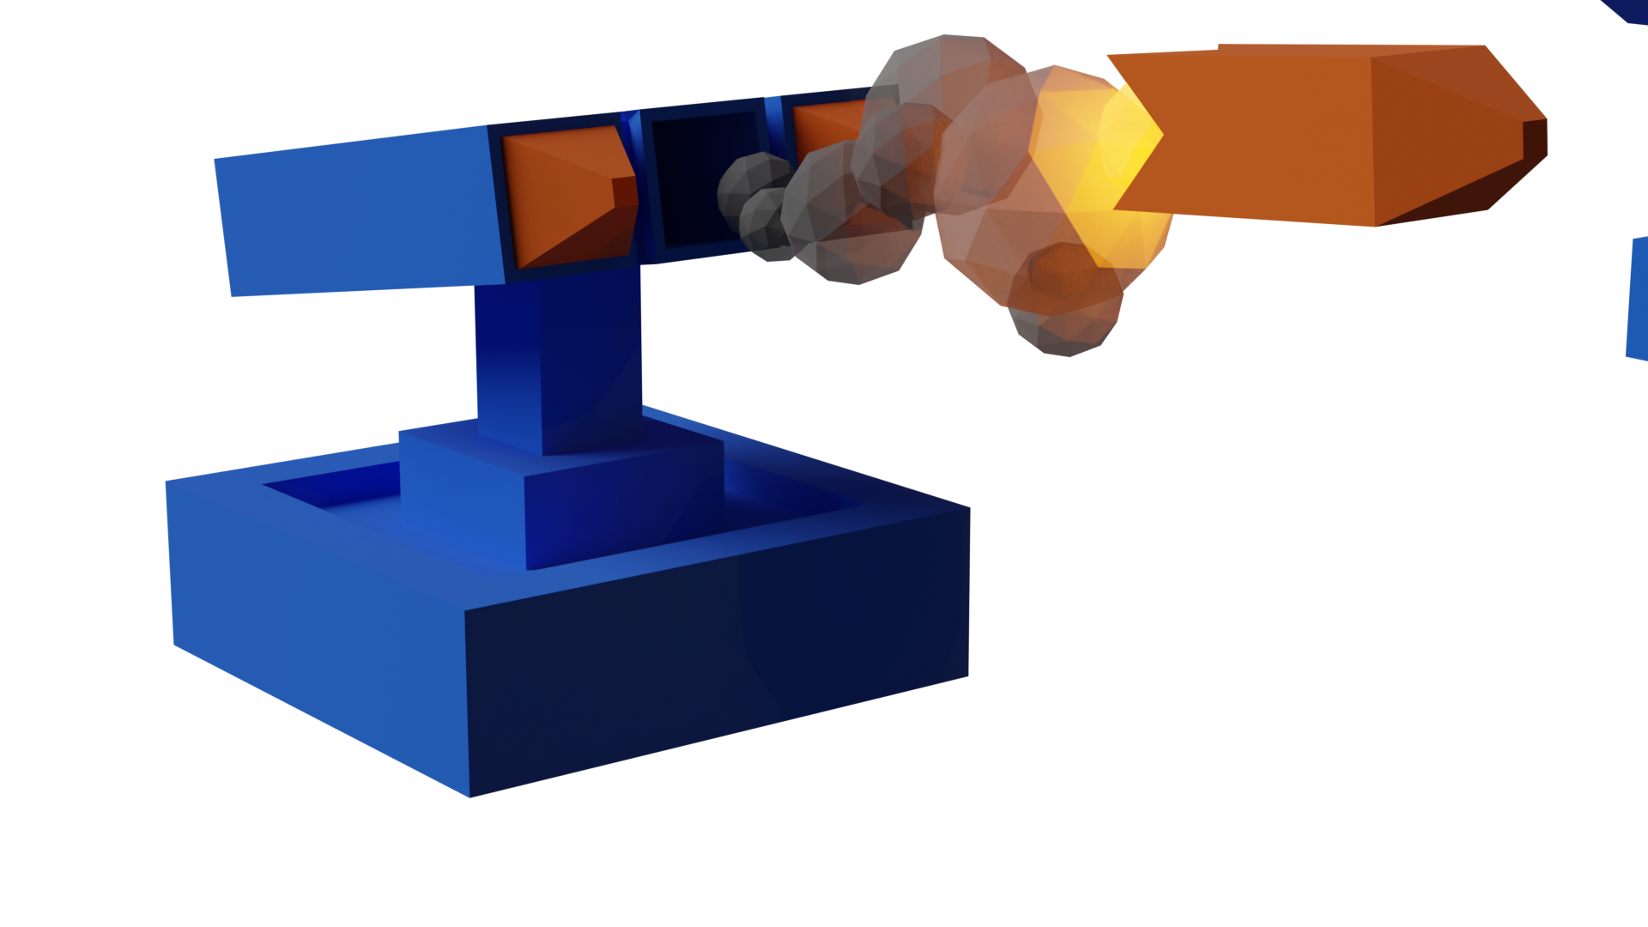
Maximising Engagement
Our projected development costs are £1,500,000 including art, programming, and marketing.
Revenue streams: In-app purchases, ad views, and optional subscriptions.
Monetization aligns with the industry standard while keeping the game fair and enjoyable for all players.
The game will feature some asynchronous multiplayer elements to increase player retention
These include leaderboards for each enemy wave, and clans made of players, with a special clan defence mode.
To maximise engagement with the game, we have several strategies.
While players are AFK, their towers will continue to fight endless waves of weak enemies. Sometimes, a Boss Wave will appear. This is a stronger than normal wave of enemies, and without player intervention they are likely to damage the player’s base.
A notification is sent to the player when a boss wave is approaching. The player has 1 day to respond to the threat to their towers.
We will primarily rely on players skipping timers, such as the time it takes to construct new buildings and towers, for our monetisation strategy. Players will be able to use premium currency or watch ads
to reduce or skip these timers.
"Idle mechanics generate sustained player retention even during inactive gameplay, ensuring consistent ad revenue streams." (Sorvari, 2018)
In-App Ads Growth: Revenue from in-game advertising alone is projected
to hit $56 billion by 2024, indicating the importance of
ad-based monetization models for free-to-play games. (Mäkinen, 2022)
We have secured £400,000 in funding from our Kickstarter, and are providing an additional £100,000 of our own funds.
This means we require another £1,000,000 to fund the development up until release.
Notes:
Players will also be able to purchase special décor and skins for their towers which will increase the work on our artists a bit but the reward is greatly increased scope for monetisation
Mäkinen, J. (2022). Creating a Monetization Model for a Free-to-play Mobile Game.
Sorvari, T. (2018). Retention and Monetization Features in Free-to-Play Games.
Ascarza, E., Netzer, O., & Runge, J. (2023). Personalized Game Design for Improved Monetization. SSRN

Slide 18
We will primarily rely on players skipping timers, such as the time it takes to construct new buildings and towers, for our monetisation strategy. Players will be able to use premium currency or watch ads
to reduce or skip these timers.
Maximising Engagement
Thanks for listening.
Questions are welcome.
To maximise engagement with the game, we have several strategies.
While players are AFK, their towers will continue to fight endless waves of weak enemies. Sometimes, a Boss Wave will appear. This is a stronger than normal wave of enemies, and without player intervention they are likely to damage the player’s base.
A notification is sent to the player when a boss wave is approaching. The player has 1 day to respond to the threat to their towers.
The game will feature some asynchronous multiplayer elements to increase player retention
These include leaderboards for each enemy wave, and clans made of players, with a special clan defence mode.
"Idle mechanics generate sustained player retention even during inactive gameplay, ensuring consistent ad revenue streams." (Sorvari, 2018)
In-App Ads Growth: Revenue from in-game advertising alone is projected
to hit $56 billion by 2024, indicating the importance of
ad-based monetization models for free-to-play games. (Mäkinen, 2022)
Notes:
The player will occasionally receive notifications. We don’t want to harass them or make them irritated at the game, and the punishment for not engaging with these notifications will be very minor.
Player gets notifications for buildings being completed, boss waves approaching, if their highscores are beaten, and more

Slide 19
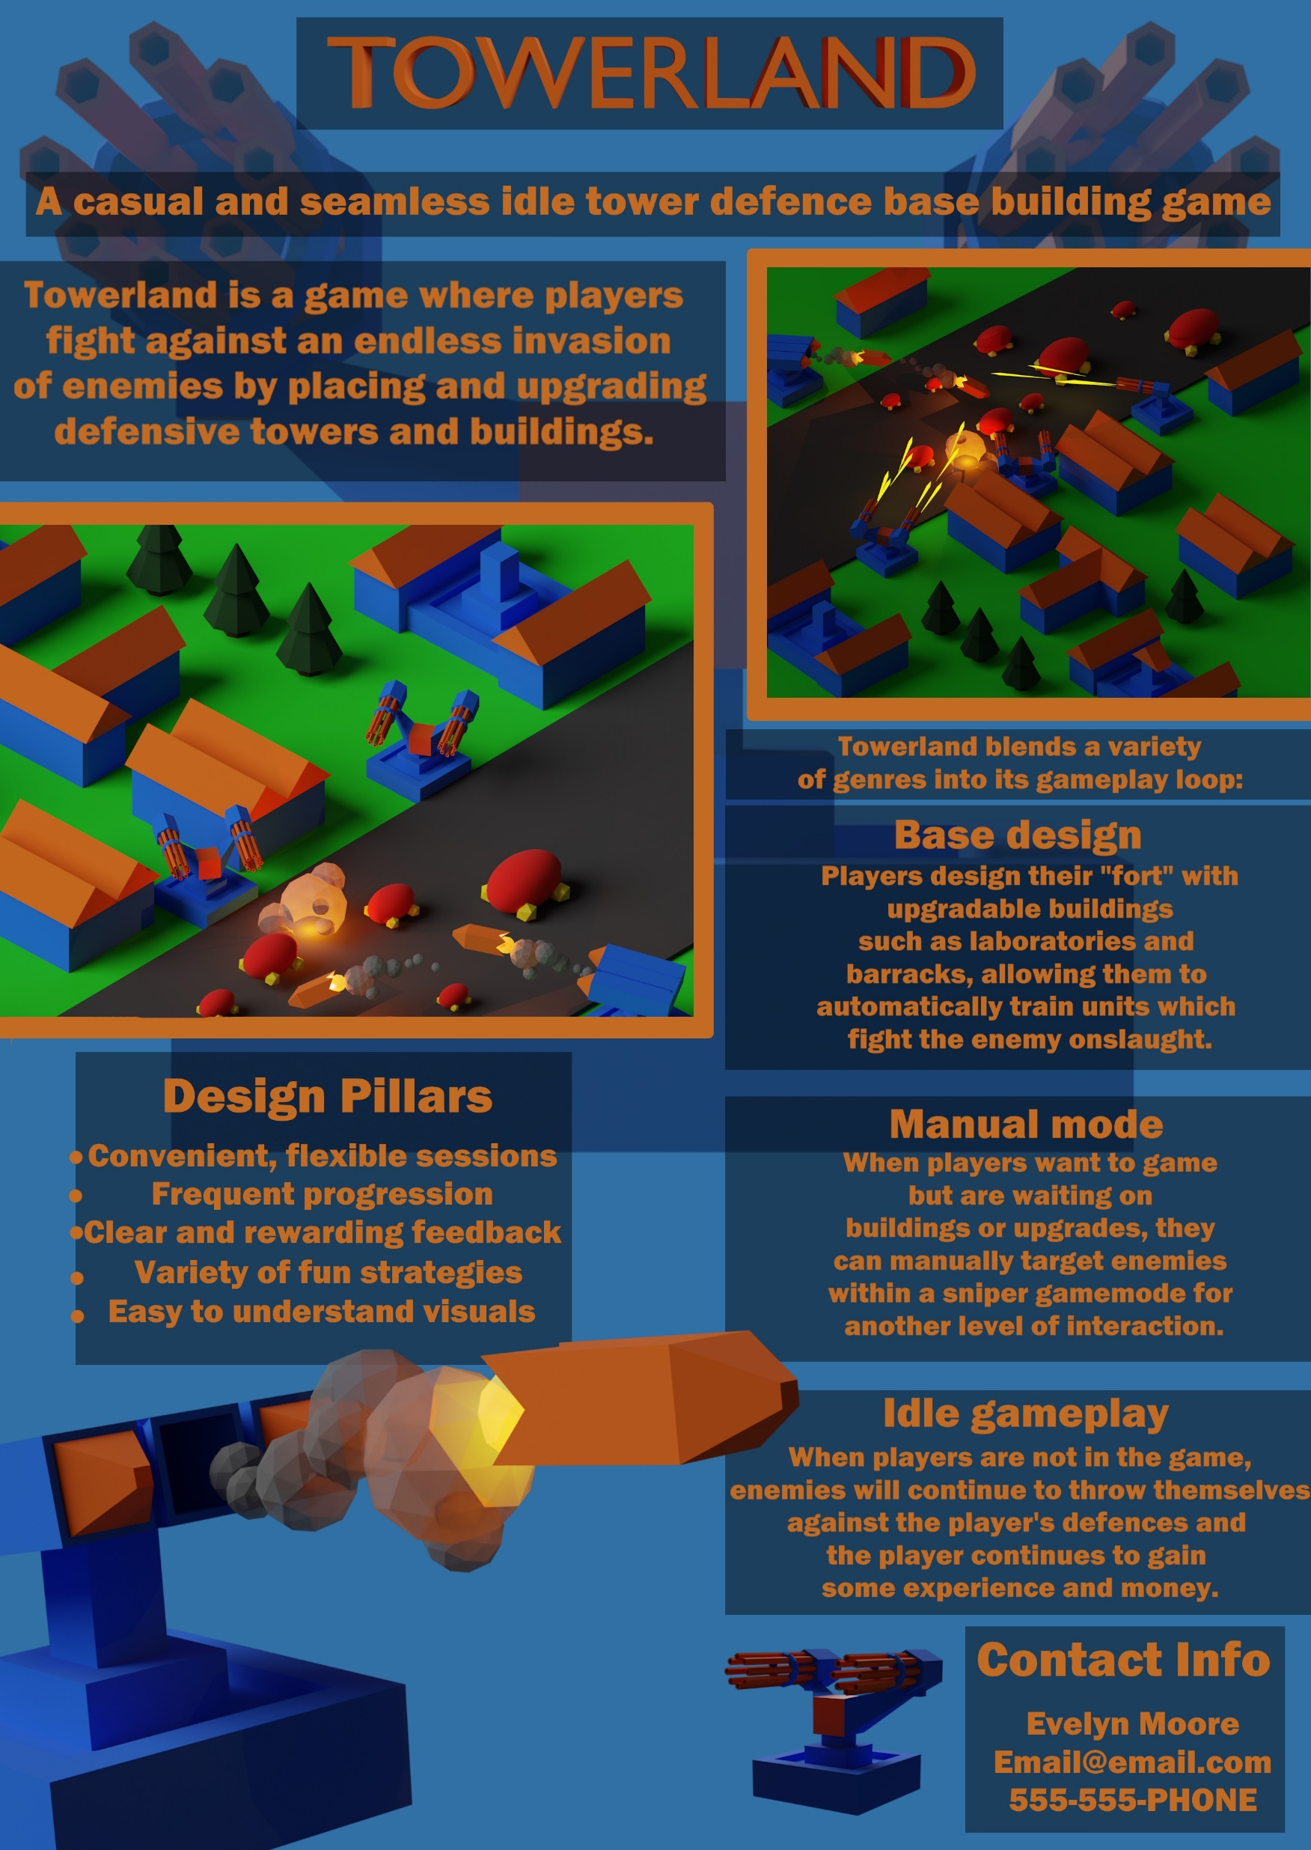
Maximising Engagement
To maximise engagement with the game, we have several strategies.
While players are AFK, their towers will continue to fight endless waves of weak enemies. Sometimes, a Boss Wave will appear. This is a stronger than normal wave of enemies, and without player intervention they are likely to damage the player’s base.
A notification is sent to the player when a boss wave is approaching. The player has 1 day to respond to the threat to their towers.
The game will feature some asynchronous multiplayer elements to increase player retention
These include leaderboards for each enemy wave, and clans made of players, with a special clan defence mode.
Sell Sheet
Thanks for listening.
Questions are welcome.
Notes:
Thank you for listening. I hope you agree that Towerland is a promising project with a bright financial future and a solid team behind it. Please feel free to ask any questions.

Slide 20
Sell Sheet
Thanks for listening.
Questions are welcome.
Notes:
Here is my sell sheet created for Towerland, by TowerStart Games.

